Slide 1
GRAVITY AFFECT

Slide 2
SUMMARY

Slide 3
DISCLAIMER

Slide 4
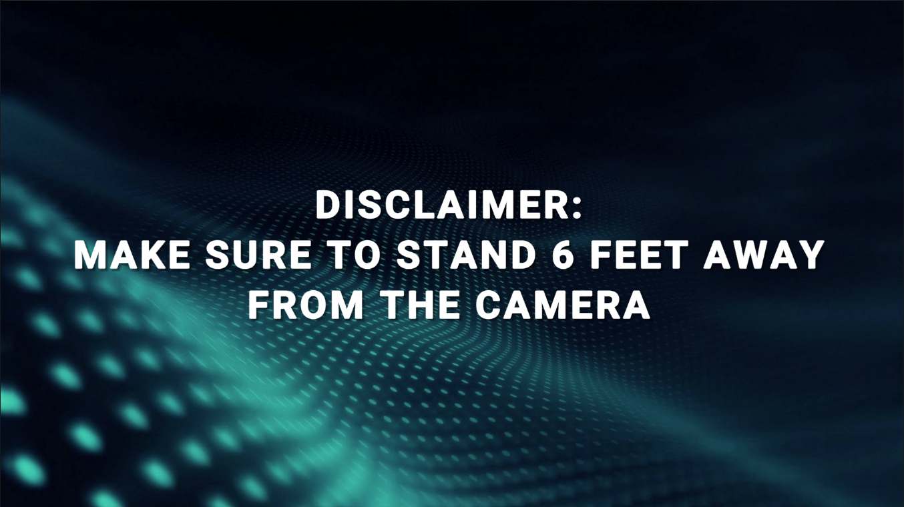

Slide 5
TITLE

Slide 6
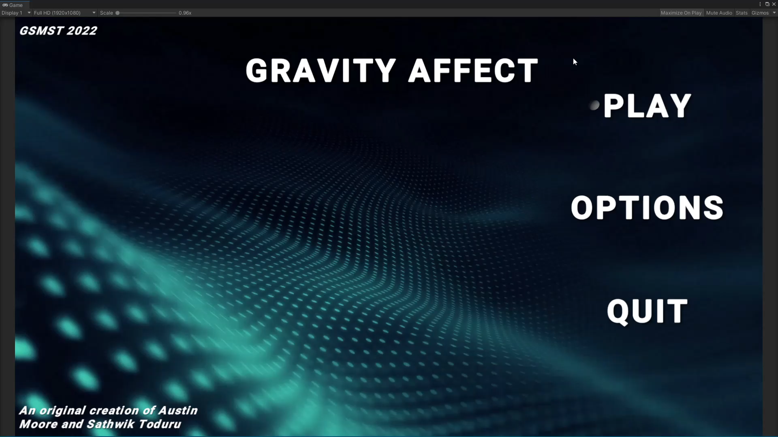
Video of title screen

Slide 7
OPTION

Slide 8
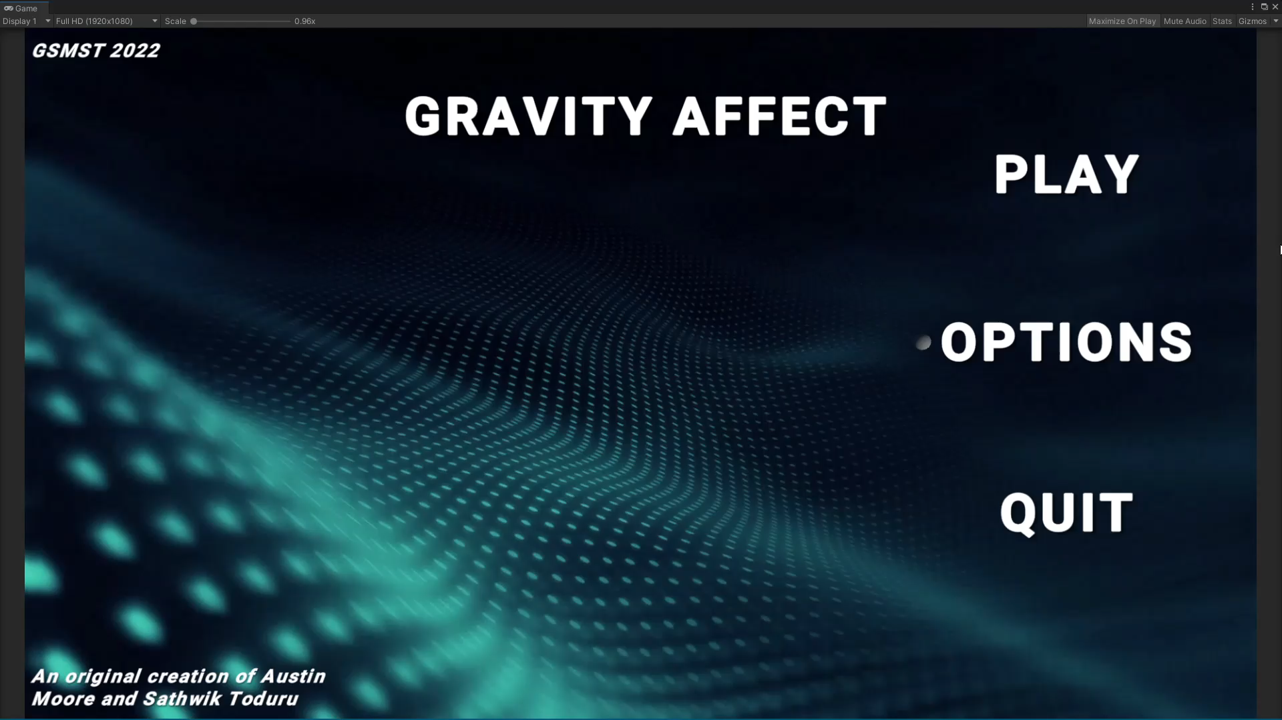
Video of options menu

Slide 9
TILTING
METHODS
NORMAL AND ALTERNATE

Slide 10
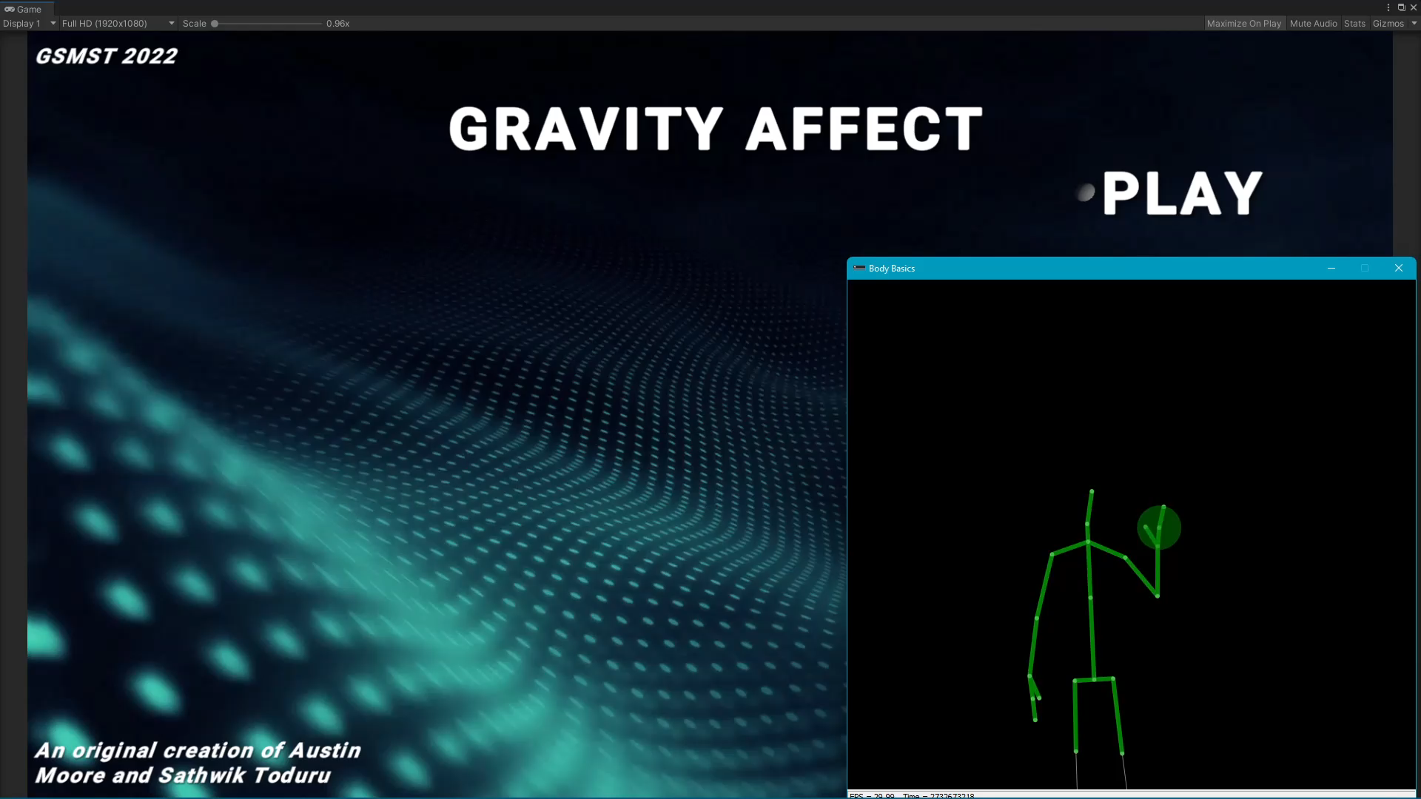
Video of tilting methods

Slide 11
TUTORIAL
LEVELS

Slide 12
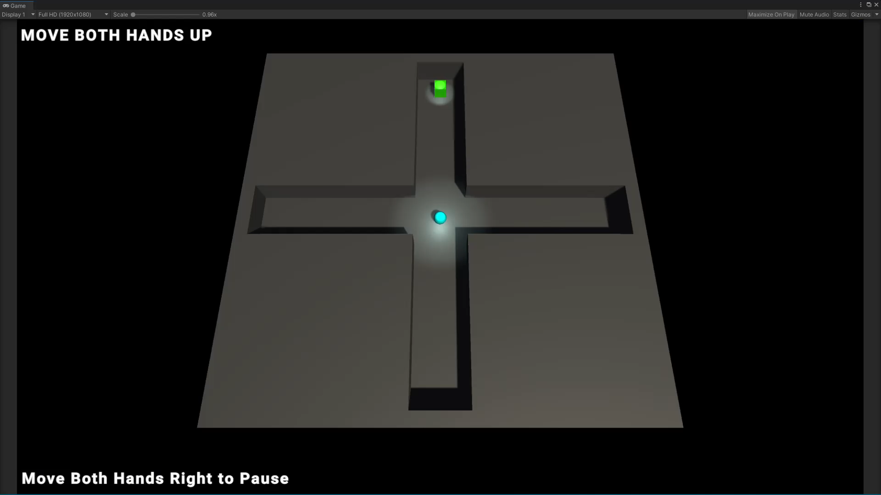
Video of tutorial levels

Slide 13
DOORS
AND EXITS

Slide 14
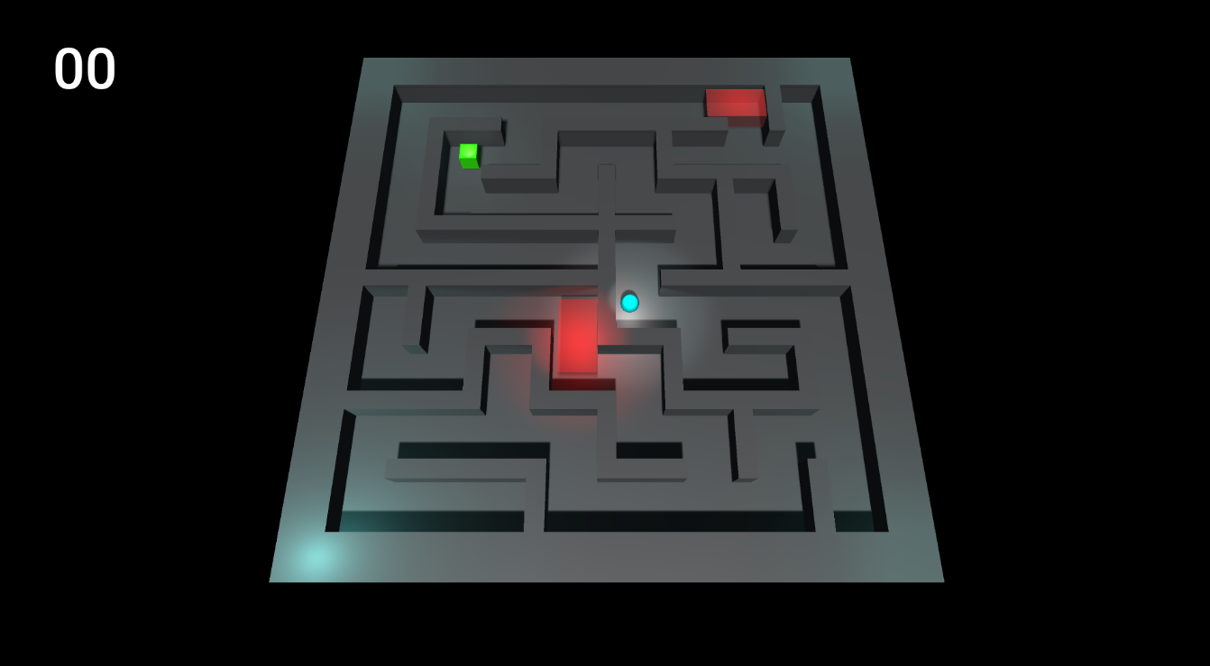

Slide 15
TIMER

Slide 16
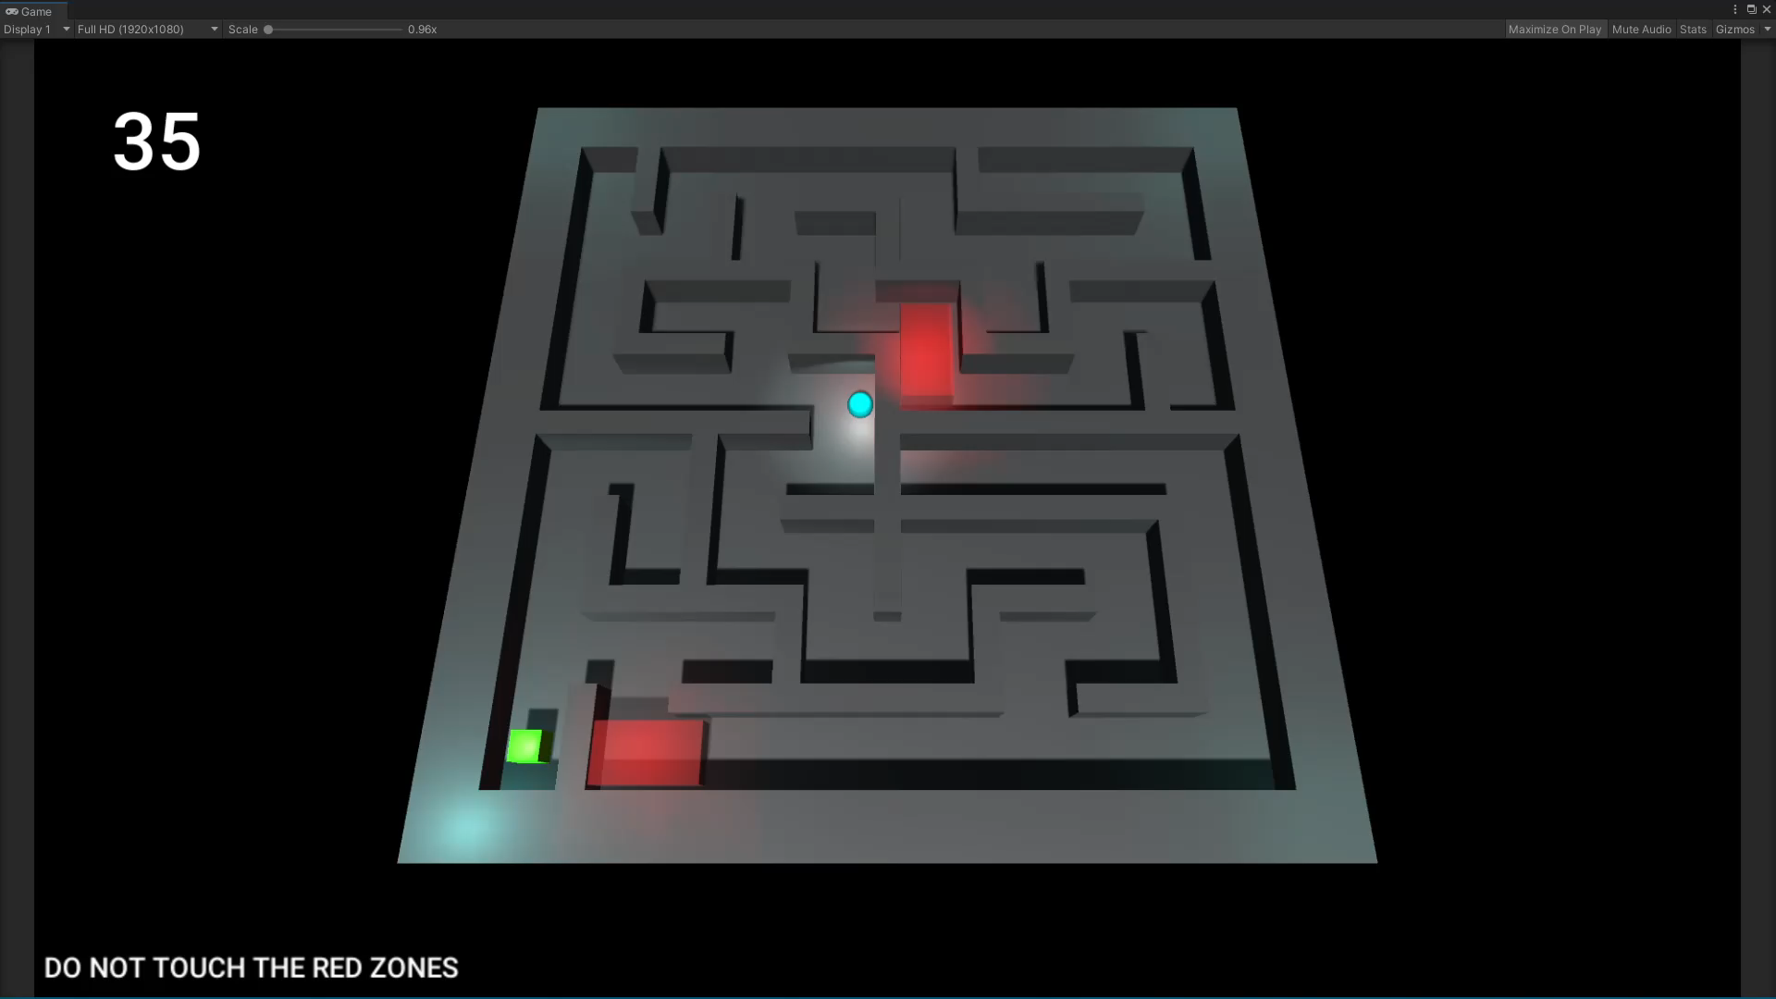
Video of timer

Slide 17
DANGER
ZONE

Slide 18
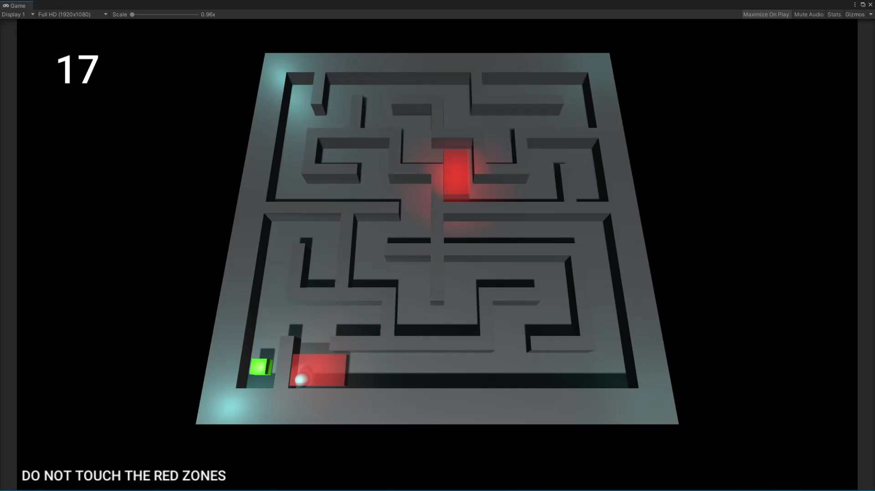
Video of danger zone and timer

Slide 19
LIGHTING

Slide 20
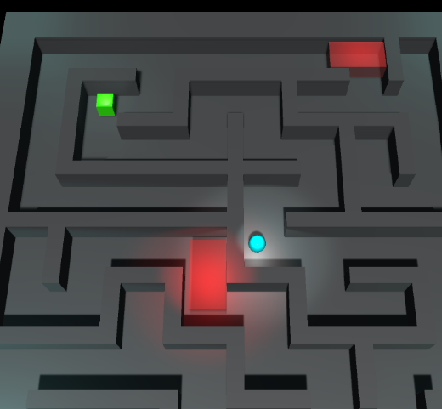

Slide 21
PAUSE
MENU

Slide 22

Video of pause menu

